Slide 1
B
I
D
M
A
S
Brackets
Indices
Divide / Multiply
Add / Subtract

Slide 2
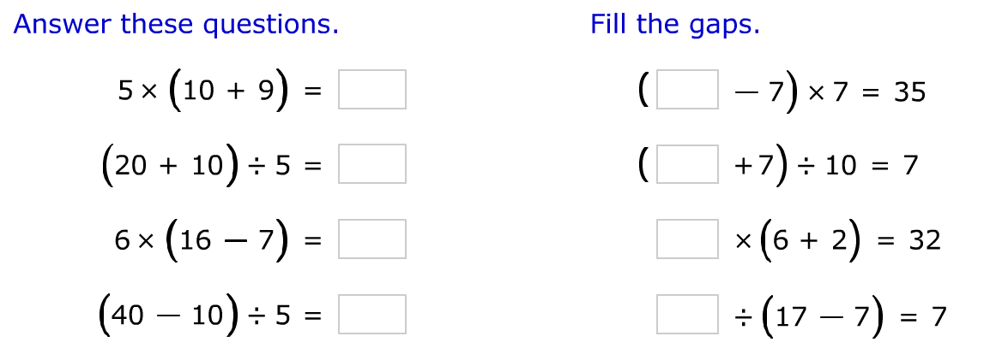
Brackets

Slide 3
BIDMAS
24 + 35 ÷ 5
70 – 24 ÷ 6
44 – 5 x 6
5 + (4 x 8)

Slide 4
Order of Operations
My Maths Algebra
Expressions & Formulae
Order of Operations Lesson

Slide 5
Interactive activities
Word problems
77 - 8 x 4

Slide 6
Misconceptions
4 x 10 ÷ 2
8 - 3 + 2
4 x 9 ÷ 3
26 - 9 + 5

Slide 7
Misconceptions
15 - 12 ÷ 4 + 2
2 x 9 + 6 ÷ 3

Slide 8
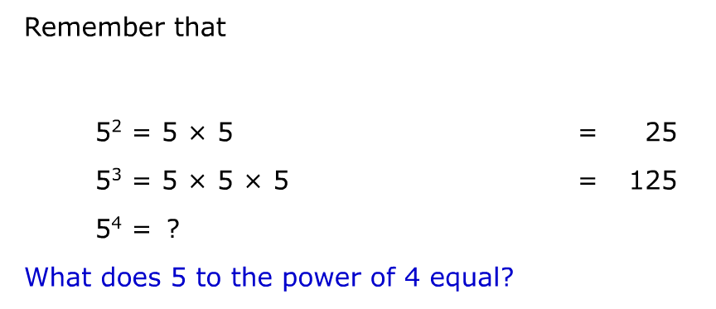
Indices
What is 5²?

Slide 9
Indices
5 ²
6² + 10
3³
7² - 2³

